Slide 1
Decision Tree: Outline
Decision tree representation
ID3 learning algorithm
Entropy, information gain
Overfitting
Babu Ram Dawadi

Slide 2
Defining the Task
Imagine we’ve got a set of data containing several types, or classes.
  E.g. information about customers, and class=whether or not they buy anything.
Can we predict, i.e classify, whether a previously unseen customer will buy something?
Babu Ram Dawadi

Slide 3
An Example Decision Tree
Attribute_{n}
v_{n1}
v_{n3}
v_{n2}
Attribute_{m}
Attribute_{k}
v_{m1}
v_{m2}
Class₁
v_{k1}
v_{k2}
Attribute_{l}
v_{l1}
Class₂
Class₂
v_{l2}
Class₁
We create a ‘decision tree’. It acts like a function that can predict and output given an input
Class₂
Class₁

Slide 4
Decision Trees
The idea is to ask a series of questions, starting at the root, that will lead to a leaf node.
The leaf node provides the classification.
Babu Ram Dawadi

Slide 5
Algorithm for Decision Tree Induction
Basic algorithm
  Tree is constructed in a top-down recursive divide-and-conquer manner
  At start, all the training examples are at the root
  Attributes are categorical (if continuous-valued, they are discretized in advance)
  Examples are partitioned recursively based on selected attributes
  Test attributes are selected on the basis of a heuristic or statistical measure (e.g., information gain)
Conditions for stopping partitioning
  All samples for a given node belong to the same class
  There are no remaining attributes for further partitioning – majority voting is employed for classifying the leaf
  There are no samples left
Data Mining: Concepts and Techniques

Slide 6
Classification by Decision Tree Induction
Decision tree
  A flow-chart-like tree structure
  Internal node denotes a test on an attribute
  Branch represents an outcome of the test
  Leaf nodes represent class labels or class distribution
Decision tree generation consists of two phases
  Tree construction
    At start, all the training examples are at the root
    Partition examples recursively based on selected attributes
  Tree pruning
    Identify and remove branches that reflect noise or outliers
Once the tree is build
  Use of decision tree: Classifying an unknown sample

Slide 7
Decision Tree for PlayTennis
Outlook
Sunny
Overcast
Rain
Humidity
Yes
Wind
High
Normal
Strong
Weak
No
Yes
No
Yes

Slide 8
Decision Tree for PlayTennis
Outlook
Sunny
Overcast
Rain
Humidity
Each internal node tests an attribute
High
Normal
Each branch corresponds to an
attribute value node
No
Yes
Each leaf node assigns a classification

Slide 9
Decision Tree for PlayTennis
Outlook Temperature Humidity Wind PlayTennis
Sunny Hot High Weak ?
No
Outlook
Sunny
Overcast
Rain
Humidity
Yes
Wind
High
Normal
Strong
Weak
No
Yes
No
Yes

Slide 10
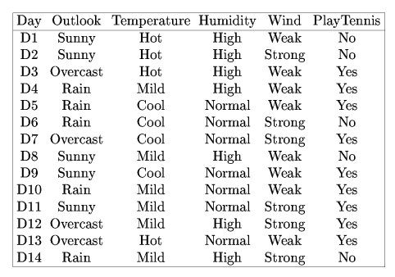
Decision Trees
Consider these data:
A number of examples of weather, for several days, with a classification ‘PlayTennis.’

Slide 11
Decision Tree Algorithm
Building a decision tree
Select an attribute
Create the subsets of the example data for each value of the attribute
For each subset
  if not all the elements of the subset belongs to same class repeat the steps 1-3 for the subset

Slide 12
Building Decision Trees
Let’s start building the tree from scratch. We first need to decide which attribute to make a decision. Let’s say we selected “humidity”
Humidity
high
normal
D1,D2,D3,D4
D8,D12,D14
D5,D6,D7,D9
D10,D11,D13
Babu Ram Dawadi

Slide 13
Building Decision Trees
Now lets classify the first subset D1,D2,D3,D4,D8,D12,D14 using attribute “wind”
Humidity
high
normal
D1,D2,D3,D4
D8,D12,D14
D5,D6,D7,D9
D10,D11,D13

Slide 14
Building Decision Trees
Subset D1,D2,D3,D4,D8,D12,D14 classified by attribute “wind”
Humidity
high
normal
wind
D5,D6,D7,D9
D10,D11,D13
strong
weak
D2,D12,D14
D1,D3,D4,D8

Slide 15
Building Decision Trees
Now lets classify the subset D2,D12,D14 using attribute “outlook”
Humidity
high
normal
wind
D5,D6,D7,D9
D10,D11,D13
strong
weak
D2,D12,D14
D1,D3,D4,D8

Slide 16
Building Decision Trees
Subset D2,D12,D14 classified by “outlook”
Humidity
high
normal
wind
D5,D6,D7,D9
D10,D11,D13
strong
weak
D2,D12,D14
D1,D3,D4,D8

Slide 17
Building Decision Trees
subset D2,D12,D14 classified using attribute “outlook”
Humidity
high
normal
wind
D5,D6,D7,D9
D10,D11,D13
strong
weak
outlook
D1,D3,D4,D8
Sunny
Rain
Overcast
No
No
Yes

Slide 18
Building Decision Trees
Now lets classify the subset D1,D3,D4,D8 using attribute “outlook”
Humidity
high
normal
wind
D5,D6,D7,D9
D10,D11,D13
strong
weak
outlook
D1,D3,D4,D8
Sunny
Rain
Overcast
No
No
Yes

Slide 19
Building Decision Trees
subset D1,D3,D4,D8 classified by “outlook”
Humidity
high
normal
wind
D5,D6,D7,D9
D10,D11,D13
strong
weak
outlook
outlook
Sunny
Rain
Overcast
Sunny
Rain
Overcast
No
No
Yes
No
Yes
Yes

Slide 20
Building Decision Trees
Now classify the subset D5,D6,D7,D9,D10,D11,D13 using attribute “outlook”
Humidity
high
normal
wind
D5,D6,D7,D9
D10,D11,D13
strong
weak
outlook
outlook
Sunny
Rain
Overcast
Sunny
Rain
Overcast
No
No
Yes
No
Yes
Yes

Slide 21
Building Decision Trees
subset D5,D6,D7,D9,D10,D11,D13 classified by “outlook”
Humidity
high
normal
wind
outlook
strong
weak
Sunny
Rain
Overcast
outlook
outlook
Yes
D5,D6,D10
Yes
Sunny
Rain
Overcast
Sunny
Rain
Overcast
No
No
Yes
No
Yes
Yes

Slide 22
Building Decision Trees
Finally classify subset D5,D6,D10by “wind”
Humidity
high
normal
wind
outlook
strong
weak
Sunny
Rain
Overcast
outlook
outlook
Yes
D5,D6,D10
Yes
Sunny
Rain
Overcast
Sunny
Rain
Overcast
No
No
Yes
No
Yes
Yes

Slide 23
Building Decision Trees
subset D5,D6,D10 classified by “wind”
Humidity
high
normal
wind
outlook
strong
weak
Sunny
Rain
Overcast
outlook
outlook
Yes
wind
Yes
Sunny
Rain
Overcast
Sunny
Rain
Overcast
strong
weak
No
No
Yes
No
Yes
Yes
No
Yes

Slide 24
Decision Trees and Logic
(humidity=high ∧ wind=strong ∧ outlook=overcast) ∨
(humidity=high ∧ wind=weak ∧ outlook=overcast) ∨
(humidity=normal ∧ outlook=sunny) ∨
(humidity=normal ∧ outlook=overcast) ∨
(humidity=normal ∧ outlook=rain ∧ wind=weak) ⇒ ‘Yes’
The decision tree can be expressed as an expression or if-then-else sentences:
Humidity
high
normal
wind
outlook
strong
weak
Sunny
Rain
Overcast
outlook
outlook
Yes
wind
Yes
Sunny
Rain
Overcast
Sunny
Rain
Overcast
strong
weak
No
No
Yes
No
Yes
Yes
No
Yes

Slide 25
Using Decision Trees
Now let’s classify an unseen example: <sunny,hot,normal,weak>=?
Humidity
high
normal
wind
outlook
strong
weak
Sunny
Rain
Overcast
outlook
outlook
Yes
wind
Yes
Sunny
Rain
Overcast
Sunny
Rain
Overcast
strong
weak
No
No
Yes
No
Yes
Yes
No
Yes

Slide 26
Using Decision Trees
Classifying: <sunny,hot,normal,weak>=?
Humidity
high
normal
wind
outlook
strong
weak
Sunny
Rain
Overcast
outlook
outlook
Yes
wind
Yes
Sunny
Rain
Overcast
Sunny
Rain
Overcast
strong
weak
No
No
Yes
No
Yes
Yes
No
Yes

Slide 27
Using Decision Trees
Classification for: <sunny,hot,normal,weak>=Yes
Humidity
high
normal
wind
outlook
strong
weak
Sunny
Rain
Overcast
outlook
outlook
Yes
wind
Yes
Sunny
Rain
Overcast
Sunny
Rain
Overcast
strong
weak
No
No
Yes
No
Yes
Yes
No
Yes

Slide 28
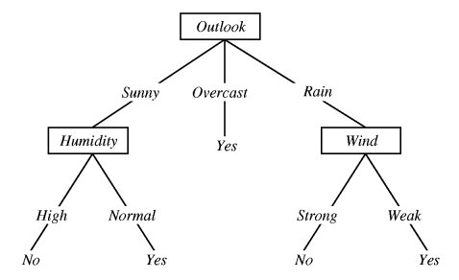
A Big Problem…
Here’s another tree from the same training data that has a different attribute order:
Which attribute should we choose for each branch?

Slide 29
Choosing Attributes
We need a way of choosing the best attribute each time we add a node to the tree.
Most commonly we use a measure called entropy.
Entropy measure the degree of disorder in a set of objects.

Slide 30
Entropy
In our system we have
  9 positive examples
  5 negative examples
The entropy, E(S), of a set of examples is:
  E(S) = Σ-p_{i} log p_{i}
  Where c = no of classes and p_{i} = ratio of the number of examples of this value over the total number of examples.
P+ = 9/14
P- = 5/14
E = - 9/14 log₂ 9/14 - 5/14 log₂ 5/14
E = 0.940
c
- In a homogenous (totally ordered) system, the entropy is 0.
- In a totally heterogeneous system (totally disordered), all classes have equal numbers of instances; the entropy is 1
i=1

Slide 31
Entropy
We can evaluate each attribute for their entropy.
  E.g. evaluate the attribute “Temperature”
  Three values: ‘Hot’, ‘Mild’, ‘Cool.’
So we have three subsets, one for each value of ‘Temperature’.
S_{hot}={D1,D2,D3,D13}
S_{mild}={D4,D8,D10,D11,D12,D14}
S_{cool}={D5,D6,D7,D9}
We will now find:
E(S_{hot})
E(S_{mild})
E(S_{cool})

Slide 32
Entropy
S_{hot}= {D1,D2,D3,D13}
Examples:
2 positive
2 negative
Totally heterogeneous + disordered therefore:
p₊= 0.5
p₋= 0.5
Entropy(S_{hot}),=
-0.5log₂0.5
-0.5log₂0.5 = 1.0
S_{mild}= {D4,D8,D10,
D11,D12,D14}
Examples:
4 positive
2 negative
Proportions of each class in this subset:
p₊= 0.666
p₋= 0.333
Entropy(S_{mild}),=
-0.666log₂0.666
-0.333log₂0.333 = 0.918
S_{cool}={D5,D6,D7,D9}
Examples:
3 positive
1 negative
Proportions of each class in this subset:
p₊= 0.75
p₋= 0.25
Entropy(S_{cool}),=
-0.25log₂0.25
-0.75log₂0.75 = 0.811

Slide 33

Gain
Now we can compare the entropy of the system before we divided it into subsets using “Temperature”, with the entropy of the system afterwards. This will tell us how good “Temperature” is as an attribute.
The entropy of the system after we use attribute “Temperature” is:
(|S_{hot}|/|S|)*E(S_{hot}) + (|S_{mild}|/|S|)*E(S_{mild}) + (|S_{cool}|/|S|)*E(S_{cool})
(4/14)*1.0 + (6/14)*0.918 + (4/14)*0.811 = 0.9108
This difference between the entropy of the system before and after the split into subsets is called the gain:
E(before)
E(afterwards)
Gain(S,Temperature) = 0.940 - 0.9108 = 0.029

Slide 34
Decreasing Entropy
…to the final state where all subsets contain a single class
From the initial state,
Where there is total disorder…
no
no
Has a ring?
yes
Has a cross?
no
Has a ring?
yes
yes
7red class 7pink class: E=1.0
Both subsets
E=-2/7log2/7 –5/7log5/7
All subset: E=0.0

Slide 35
Tabulating the Possibilities
Attribute=value | |+| | |-| | E | E after dividing by attribute A | Gain
Outlook=sunny | 2 | 3 | -2/5 log 2/5 – 3/5 log 3/5 = 0.9709 | 0.6935 | 0.2465
Outlook=o’cast | 4 | 0 | -4/4 log 4/4 – 0/4 log 0/4 = 0.0
Outlook=rain | 3 | 2 | -3/5 log 3/5 – 2/5 log 2/5 = 0.9709
Temp’=hot | 2 | 2 | -2/2 log 2/2 – 2/2 log 2/2 = 1.0 | 0.9108 | 0.0292
Temp’=mild | 4 | 2 | -4/6 log 4/6 – 2/6 log 2/6 = 0.9183
Temp’=cool | 3 | 1 | -3/4 log 3/4 – 1/4 log 1/4 = 0.8112
Etc…
… etc
This shows the entropy calculations…

Slide 36
Table continued…
E for each subset of A | Weight by proportion of total | E after A is the sum of the weighted values | Gain = (E before dividing by A) – (E after A)
-2/5 log 2/5 – 3/5 log 3/5 = 0.9709 | 0.9709 x 5/14 = 0.34675 | 0.6935 | 0.2465
-4/4 log 4/4 – 0/4 log 0/4 = 0.0 | 0.0 x 4/14 = 0.0
-3/5 log 3/5 – 2/5 log 2/5 = 0.9709 | 0.9709 x 5/14 = 0.34675
-2/2 log 2/2 – 2/2 log 2/2 = 1.0 | 1.0 x 4/14 = 0.2857 | 0.9109 | 0.0292
-4/6 log 4/6 – 2/6 log 2/6 = 0.9183 | 0.9183 x 6/14 = 0.3935
-3/4 log 3/4 – 1/4 log 1/4 = 0.8112 | 0.8112 x 4/14 = 0.2317
…and this shows the gain calculations

Slide 37
Gain
We calculate the gain for all the attributes.
Then we see which of them will bring more ‘order’ to the set of examples.
Gain(S,Outlook) = 0.246
Gain(S,Humidity) = 0.151
Gain(S,Wind) = 0.048
Gain(S, Temp’) = 0.029
The first node in the tree should be the one with the highest value, i.e. ‘Outlook’.

Slide 38
ID3 (Decision Tree Algorithm: (Quinlan 1979))
ID3 was the first proper decision tree algorithm to use this mechanism:
Building a decision tree with ID3 algorithm
Select the attribute with the most gain
Create the subsets for each value of the attribute
For each subset
  if not all the elements of the subset belongs to same class repeat the steps 1-3 for the subset
Main Hypothesis of ID3: The simplest tree that classifies training examples will work best on future examples (Occam’s Razor)

Slide 39
ID3 (Decision Tree Algorithm)
Function DecisionTtreeLearner(Examples, TargetClass, Attributes)
create a Root node for the tree
if all Examples are positive, return the single-node tree Root, with label = Yes
if all Examples are negative, return the single-node tree Root, with label = No
if Attributes list is empty,
  return the single-node tree Root, with label = most common value of TargetClass in Examples
else
  A = the attribute from Attributes with the highest information gain with respect to Examples
  Make A the decision attribute for Root
  for each possible value v of A:
    add a new tree branch below Root, corresponding to the test A = v
    let Examplesv be the subset of Examples that have value v for attribute A
    if Examplesv is empty then
      add a leaf node below this new branch with label = most common value of TargetClass in Examples
    else
      add the subtree DTL(Examplesv, TargetClass, Attributes - { A })
    end if
end
return Root

Slide 40
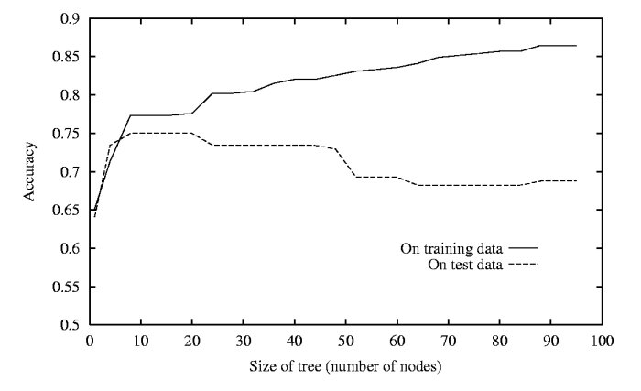
The Problem of Overfitting
Trees may grow to include irrelevant attributes
Noise may add spurious nodes to the tree.
This can cause overfitting of the training data relative to test data.
Hypothesis H overfits the data if there exists H’ with greater error than H, over training examples, but less error than H over entire distribution of instances.

Slide 41
Fixing Over-fitting
Two approaches to pruning
Prepruning: Stop growing tree during the training when it is determined that there is not enough data to make reliable choices.
Postpruning: Grow whole tree but then remove the branches that do not contribute good overall performance.

Slide 42

Rule Post-Pruning
Rule post-pruning
prune (generalize) each rule by removing any preconditions (i.e., attribute tests) that result in improving its accuracy over the validation set
sort pruned rules by accuracy, and consider them in this order when classifying subsequent instances
IF (Outlook = Sunny) ^ (Humidity = High) THEN PlayTennis = No
Try removing (Outlook = Sunny) condition or (Humidity = High) condition from the rule and select whichever pruning step leads to the biggest improvement in accuracy on the validation set (or else neither if no improvement results).
converting to rules improves readability

Slide 43
Advantage and Disadvantages of Decision Trees
Advantages:
  Easy to understand and map nicely to a production rules
  Suitable for categorical as well as numerical inputs
  No statistical assumptions about distribution of attributes
  Generation and application to classify unknown outputs is very fast
Disadvantages:
  Output attributes must be categorical
  Unstable: slight variations in the training data may result in different attribute selections and hence different trees
  Numerical input attributes leads to complex trees as attribute splits are usually binary

Slide 44
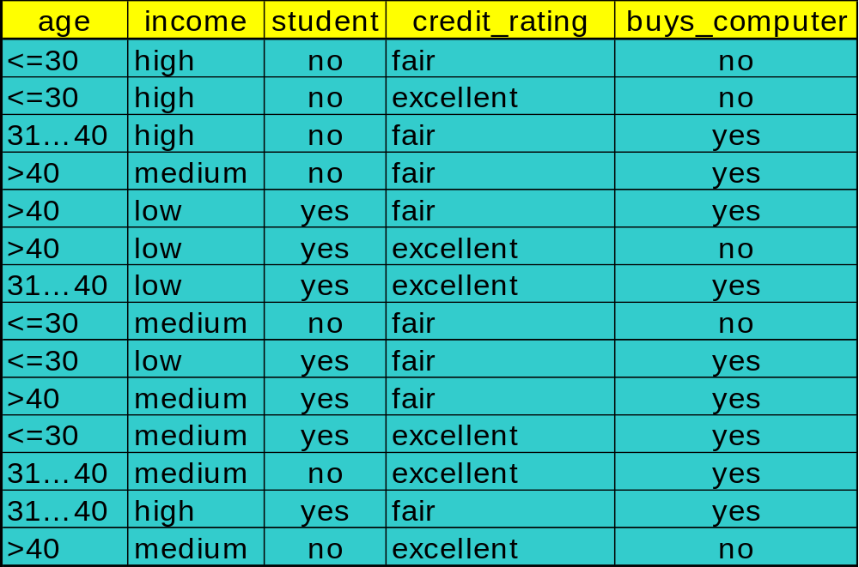
Assignment
Given the training data set, to identify whether a customer buys computer or not, Develop a Decision Tree using ID3 technique.

Slide 45
Association Rules
Example1: a female shopper buys a handbag is likely to buy shoes
Example2: when a male customer buys beer, he is likely to buy salted peanuts
It is not very difficult to develop algorithms that will find this associations in a large database
  The problem is that such an algorithm will also uncover many other associations that are of very little value.

Slide 46
Association Rules
It is necessary to introduce some measures to distinguish interesting associations from non-interesting ones
Look for associations that have a lots of examples in the database: support of an association rule
May be that a considerable group of people who read all three magazines but there is a much larger group that buys A & B, but not C; association is very weak here although support might be very high.

Slide 47
Associations….
Percentage of records for which C holds, within the group of records for which A & B hold: confidence
Association rules are only useful in data mining if we already have a rough idea of what is we are looking for.
We will represent an association rule in the following way:
  MUSIC_MAG, HOUSE_MAG=>CAR_MAG
  Somebody that reads both a music and a house magazine is also very likely to read a car magazine

Slide 48
Associations…
Example: shopping Basket analysis
Transactions | Chips | Rasbari | Samosa | Coke | Tea
T1 |  | X | X
T2 | X | X
T3 |  | X | X |  | X
Babu Ram Dawadi

Slide 49
Example…
1. find all frequent Itemsets:
(a) 1-itemsets
  K= [{Chips}C=1,{Rasbari}C=3,{Samosa}C=2, {Tea}C=1]
(b) extend to 2-itemsets:
  L=[{Chips, Rasbari}C=1, {Rasbari,Samosa}C=2,{Rasbari,Tea}C=1,{Samosa,Tea}C=1]
(c) Extend to 3-Itemsets:
  M=[{Rasbari, Samosa,Tea}C=1

Slide 50
Examples..
Match with the requirements:
  Min. Support is 2 (66%)
  (a) >> K1={{Rasbari}, {Samosa}}
  (b) >>L1={Rasbari,Samosa}
  (c) >>M1={}
Build All possible rules:
  (a) no rule
  (b) >> possible rules:
    Rasbari=>Samosa
    Samosa=>Rasbari
  (c) No rule
Support: given the association rule X1,X2…Xn=>Y, the support is the Percentage of records for which X1,X2…Xn and Y both hold true.

Slide 51
Example..
Calculate Confidence for b:
  Confidence of [Rasbari=>Samosa]
    {Rasbari,Samosa}C=2/{Rasbari}C=3
    =2/3
    66%
  Confidence of Samosa=> Rasbari
    {Rasbari,Samosa}C=2/{Samosa}C=2
    =2/2
    100%
Confidence: Given the association rule X1,X2….Xn=>Y, the confidence is the percentage of records for which Y holds within the group of records for which X1,X2…Xn holds true.

Slide 52
The A-Priori Algorithm
Set the threshold for support rather high – to focus on a small number of best candidates,
Observation: If a set of items X has support s, then each subset of X must also have support at least s.
( if a pair {i,j} appears in say, 1000 baskets, then we know there are at least 1000 baskets with item i and at least 1000 baskets with item j )
Algorithm:
Find the set of candidate items – those that appear in a sufficient number of baskets by themselves
Run the query on only the candidate items

Slide 53
Apriori Algorithm
Begin
Initialise the candidate Item-sets as single items in database.
Scan the database and count the frequency of the candidate item-sets, then Large Item-sets are decided based on the user specified min_sup.
Any new Large
Item-sets?
NO
YES
Based on the Large Item-sets, expand them with one more item to generate new Candidate item-sets.
Stop

Slide 54
Apriori: A Candidate Generation-and-test Approach
Any subset of a frequent itemset must be frequent
  if {beer, diaper, nuts} is frequent, so is {beer, diaper}
  Every transaction having {beer, diaper, nuts} also contains {beer, diaper}
Apriori pruning principle: If there is any itemset which is infrequent, its superset should not be generated/tested!
The performance studies show its efficiency and scalability

Slide 55
The Apriori Algorithm — An Example
Itemset | sup
{A} | 2
{B} | 3
{C} | 3
{D} | 1
{E} | 3
Database TDB
Itemset | sup
{A} | 2
{B} | 3
{C} | 3
{E} | 3
L₁
Tid | Items
10 | A, C, D
20 | B, C, E
30 | A, B, C, E
40 | B, E
C₁
1st scan
C₂
Itemset | sup
{A, B} | 1
{A, C} | 2
{A, E} | 1
{B, C} | 2
{B, E} | 3
{C, E} | 2
C₂
L₂
Itemset
{A, B}
{A, C}
{A, E}
{B, C}
{B, E}
{C, E}
Itemset | sup
{A, C} | 2
{B, C} | 2
{B, E} | 3
{C, E} | 2
2nd scan
C₃
Itemset
{B, C, E}
3rd scan
L₃
Itemset | sup
{B, C, E} | 2

Slide 56
Problems with A-priori Algorithms
It is costly to handle a huge number of candidate sets. For example if there are 10⁴ large 1-itemsets, the Apriori algorithm will need to generate more than 10⁷ candidate 2-itemsets. Moreover for 100-itemsets, it must generate more than 2¹⁰⁰ ≈ 10³⁰ candidates in total.
The candidate generation is the inherent cost of the Apriori Algorithms, no matter what implementation technique is applied.
To mine a large data sets for long patterns – this algorithm is NOT a good idea.
When Database is scanned to check Ck for creating Lk, a large number of transactions will be scanned even they do not contain any k-itemset.

Slide 57
Artificial Neural Network: Outline
Perceptrons
Multi-layer networks
Backpropagation
Neuron switching time : > 10⁻³ secs
Number of neurons in the human brain: ~10¹¹
Connections (synapses) per neuron : ~10⁴–10⁵
Face recognition : 0.1 secs
High degree of parallel computation
Distributed representations
Babu Ram Dawadi

Slide 58
Human Brain
Computers and the Brain: A Contrast
  Arithmetic: 1 brain = 1/10 pocket calculator
  Vision: 1 brain = 1000 super computers
  Memory of arbitrary details: computer wins
  Memory of real-world facts: brain wins
  A computer must be programmed explicitly
  The brain can learn by experiencing the world
Shashidhar Ram Joshi

Slide 59
Definition
“. . . Neural nets are basically mathematical models of information processing . . .”
“. . . (neural nets) refer to machines that have a structure that, at some level, reflects what is known of the structure of the brain . . .”
“A neural network is a massively parallel distributed processor . . . “
Shashidhar Ram Joshi

Slide 60
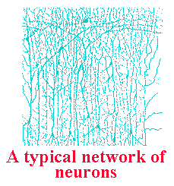
Properties of the Brain
Architectural
  80,000 neurons per square mm
  10¹¹ neurons - 10¹⁵ connections
  Most axons extend less than 1 mm (local connections)
Operational
  Highly complex, nonlinear,
  parallel computer
  Operates at millisecond speeds
Shashidhar Ram Joshi

Slide 61
Interconnectedness
Each neuron may have over a thousand synapses
Some cells in cerebral cortex may have 200,000 connections
Total number of connections in the brain “network” is astronomical—greater than the number of particles in known universe
Shashidhar Ram Joshi

Slide 62
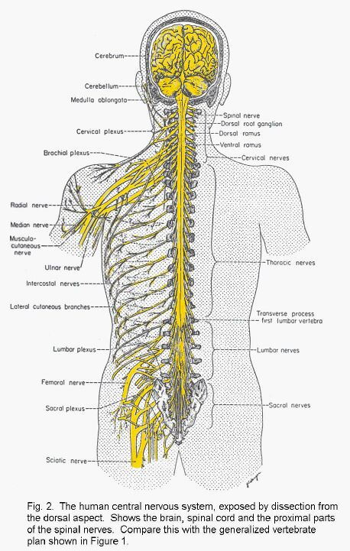
Brain and Nervous System
Around 100 billion neurons in the human brain.
Each of these is connected to many other neurons (typically 10000 connections)
Regions of the brain are (somewhat) specialised.
Some neurons connect to senses (input) and muscles (action).

Slide 63
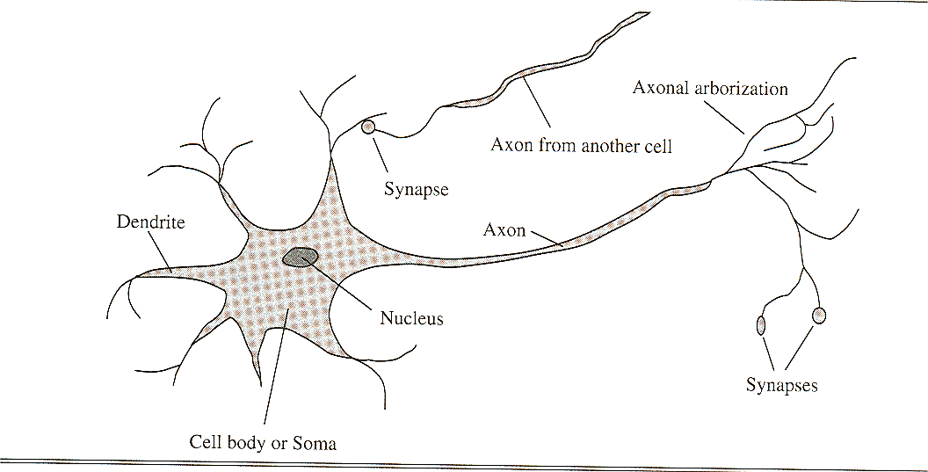
Detail of a Neuron

Slide 64

The Question
  Humans find these tasks relatively simple
    We learn by example
    The brain is responsible for our ‘computing’ power
If a machine were constructed using the fundamental building blocks found in the brain could it learn to do ‘difficult’ tasks ???
Shashidhar Ram Joshi

Slide 65
Basic Ideas in Machine Learning
Machine learning is focused on inductive learning of hypotheses from examples.
Three main forms of learning:
  Supervised learning: Examples are tagged with some “expert” information.
  Unsupervised learning: Examples are placed into categories without guidance; instead, generic properties such as “similarity” are used.
  Reinforcement learning: Examples are tested, and the results of those tests used to drive learning.

Slide 66
Neural Network: Characteristics
Highly parallel structure; hence a capability for fast computing
Ability to learn and adapt to changing system parameters
High degree of tolerance to damage in the connections
Ability to learn through parallel and distributed processing

Slide 67
Neural Networks
A neural Network is composed of a number of nodes, or units, connected by links. Each link has a numeric weight associated with it.
Each unit has a set of input links from other units, a set of output links to other units, a current activation level, and a means of computing the activation level at the next step in time.

Slide 68
Linear treshold unit (LTU)
x₀₌₁
x₁
w₁
w₀
w₂
x₂
Σ
o
.
.
.
Σ_{i=0}^{n} w_{i} x_{i}
w_{n}
Activation Unit
Output Unit
x_{n}
Input Unit
1 if Σ_{i=0}^{n} w_{i} x_{i} >0
o(x_{i})=
-1 otherwise
{

Slide 69
Layered network
Single layered
Multi layered
I1
w13
H3
w35
w14
w23
O5
w45
w24
H4
I2
Two layer, feed forward network with two inputs, two hidden nodes and one output node.

Slide 70
Perceptrons
A single-layered, feed-forward network can be taken as a perceptron.
Single Perceptron
Ij
Wj,i
Oi
Ij
Wj
O

Slide 71
Perceptron Learning Rule
w_{i} = w_{i} + Δw_{i}
Δw_{i} = η (t - o) x_{i}
t=c(x) is the target value
o is the perceptron output
η Is a small constant (e.g. 0.1) called learning rate
If the output is correct (t=o) the weights w_{i} are not changed
If the output is incorrect (t≠o) the weights w_{i} are changed
such that the output of the perceptron for the new weights
is closer to t.

Slide 72
Backpropagation
A more sophisticated architecture that contains the hidden layers in which it has random weightings on its synapses in its initial stage.
For each training instance, the actual output of the network is compared with the desired output that would give a correct answer.
  If there is a difference between the correct answer and the actual answer
    Then the weightings of the individual nodes and synapses of the network are adjusted

Slide 73
Backpropagation
    Process is repeated until the responses are more or less accurate
    Once the structure of the network stablizes, the learning stage is over, and the network is now trained and ready to categorize unknown input.
  During the training stage, the network receives examples of input and output pairs corresponding to records in the database, and adapts the weights of the different branches until all the inputs match the appropriate outputs.

Slide 74
Genetic Algorithm
Derived inspiration from biology
The most fertile area for exchange of views between biology and computer science is ‘evolutionary computing’
This area evolved from three stages or less independent development:
  Genetic algorithms
  Evolutionary programming
  Evolution strategies

Slide 75
GA..
The investigators began to see a strong relationship between these areas, and at present, genetic algorithms are consideered to be among the most successful machine-learning techniques.
In the “origin of species”, Darwin described the theory of evolution, with the ‘natural selection’ as the central notion.
  Each species has an overproduction of individuals and in a tough struggle for life, only those individuals that are best adapted to the environment survive.
The long DNA molecules, consisting of only four building blocks, suggest that all the heriditary information of a human individual, or of any living creature, has been laid down in a language of only four letters (C,G,A & T in language of genetics)

Slide 76

How large is the decision space?
If we were to look at every alternative, what would we have to do? Of course, it depends.....
Think: enzymes
  Catalyze all reactions in the cell
  Biological enzymes are composed of amino acids
  There are 20 naturally-occurring amino acids
  Easily, enzymes are 1000 amino acids long
  20^1000 = (2^1000)(10^1000) ≈ 10^1300
A reference number, a benchmark:
10^80 ≈ number of atomic particles in universe

Slide 77
How large is the decision space?
Problem: Design an icon in black & white
How many options?
  Icon is 32 x 32 = 1024 pixels
  Each pixel can be on or off, so 2^1024 options
  2^1024 ≈ (2^20)^50 ≈ (10^6)^50 = 10^300
Police faces
  10 types of eyes
  10 types of noses
  10 types of eyebrows
  10 types of head
  10 types of head shape
  10 types of mouth
  10 types of ears
  but already we have 10^7 faces

Slide 78
GA..
The collection of genetic instruction for human is about 3 billion letters long
  Each individual inherits some characteristics of the father and some of the mother.
  Individual differences between people, such as hair color and eye color, and also pre-disposition for diseases, are caused by differences in genetic coding
    Even the twins are different in numerous aspects.

Slide 79
Genetic Algorithm Components
Selection
  determines how many and which individuals breed
  premature convergence sacrifices solution quality for speed
Crossover
  select a random crossover point
  successfully exchange substructures
  00000 x 11111 at point 2 yields 00111 and 11000
Mutation
  random changes in the genetic material (bit pattern)
  for problems with billions of local optima, mutations help find the global optimum solution
Evaluator function
  rank fitness of each individual in the population
  simple function (maximum) or complex function

Slide 80
GA..
Following are the formula for constructing a genetic algorithm for the solution of problem
  Write a good coding in terms of strings of limited alphabets
  Invent an artificial environment in the computer where solution can join each other
  Develop ways in which possible solutions can be combined. Like father’s and mother’s strings are simply cut and after changing, stuck together again called cross- over
  Provide an initial population or solution set and make the computer play evolution by removing bad solutions from each generation and replacing them with mutations of good solutions
  Stop when a family of successful solutions has been produced

Slide 81
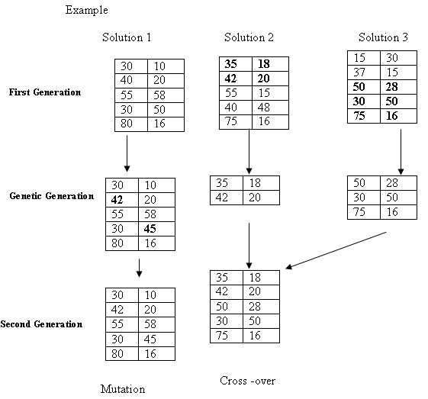
Example

Slide 82

Genetic algorithms

